Slide 1
Java classes/objects

Slide 2
Java objects
Java is an object-oriented programming language.
Everything in Java is associated with classes and objects.
An object is any entity that has a state and behavior.
For example: in real life, a car is an object.
The car has attributes, such as weight and color, and methods, such as drive and brake.

Slide 3
Java Class
A class is a blueprint for the object.
Before we create an object, we first need to define the class.
We can think of the class as a sketch (prototype) of a house.
It contains all the details about the floors, doors, windows, etc.
Based on these descriptions we build the house.
House is the object.

Slide 4
Java Class Syntax
class ClassName
{
// fields
// methods
}
fields are used to store data
methods are used to perform some operations

Slide 5
A class in Java can contain:
Fields
Methods
Constructors
Blocks
Nested class and interface

Slide 6
For bicycle object, we can create the class as:
class Bicycle {
// state or field
int gear = 5;
// behavior or method
public void braking() {
System.out.println("Working of Braking");
}
}

Slide 7
Java Objects
An object is called an instance of a class.
For example, suppose Bicycle is a class then MountainBicycle, SportsBicycle, TouringBicycle, etc can be considered as objects of the class.

Slide 8
Creating an Object in Java
Java Object Syntax: className variable_name = new className();
// for Bicycle class
Bicycle sportsBicycle = new Bicycle();
Bicycle touringBicycle = new Bicycle();

Slide 9
className is the name of class that can be anything like: Bicycle that we declared in the above example.
variable_name is name of reference variable that is used to hold the reference of created object.
The new is a keyword which is used to allocate memory for the object.

Slide 10
Example: Creating a Class and its object
public class Student{
String name;
int rollno;
int age;
void info(){
System.out.println("Name: "+name);
System.out.println("Roll Number: "+rollno);
System.out.println("Age: "+age);
}

Slide 11
public static void main(String[] args) {
Student student = new Student();
// Accessing and property value
student.name = "Ramesh";
student.rollno = 253;
student.age = 25;
// Calling method
student.info();
} }

Slide 12
Output:
Name: Ramesh
Roll Number: 253
Age: 25

Slide 13
3 ways to initialize object

Slide 14
There are 3 ways to initialize object in Java.
By reference variable
By method
By constructor

Slide 15
1) Object and Class Example: Initialization through reference
Initializing an object means storing data into the object.

Slide 16
Example
class Student{
int id;
String name;
}
class TestStudent2{
public static void main(String args[]){
Student s1=new Student();
s1.id=101;
s1.name="Sonoo";
System.out.println(s1.id+" "+s1.name);
} }

Slide 17
We can also create multiple objects and store information in it through reference variable.
class Student{
int id;
String name;
}
class TestStudent3{
public static void main(String args[]){
//Creating objects
Student s1=new Student();
Student s2=new Student();
//Initializing objects
s1.id=101;
s1.name="Sonoo";
s2.id=102;
s2.name="Amit";
System.out.println(s1.id+" "+s1.name);
System.out.println(s2.id+" "+s2.name);
}
}

Slide 18
2) Object and Class Example: Initialization through method
In this example, we are creating the two objects of Student class and initializing the value to these objects by invoking the insertRecord method.
Here, we are displaying the state (data) of the objects by invoking the displayInformation() method.

Slide 19
class Student{
int rollno;
String name;
void insertRecord(int r, String n){
rollno=r;
name=n;
}
void displayInformation(){System.out.println(rollno+" "+name);}
}
class TestStudent4{
public static void main(String args[]){
Student s1=new Student();
Student s2=new Student();
s1.insertRecord(111,"Karan");
s2.insertRecord(222,"Aryan");
s1.displayInformation();
s2.displayInformation();
}
}

Slide 20
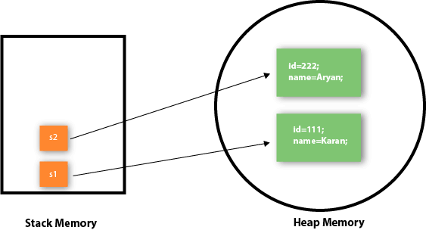
Object gets the memory in heap memory area.
The reference variable refers to the object allocated in the heap memory area.
Here, s1 and s2 both are reference variables that refer to the objects allocated in memory.

Slide 21
3) Object and Class Example: Initialization through a constructor
We will learn about constructors in Java later.

